Slide 1

DEEP NEURAL NETWORK
MODULE # 5 : DEEP FEED-FORWARD NEURAL NETWORKS
DNN Team
BITS Pilani WILP

Slide 2
The instructor is gratefully acknowledging the authors who made their course materials freely available online.
This deck is prepared by Seetha Parameswaran.
Deep Learning

Slide 3









Table of Contents
Motivation: The XOR Problem
Non-Linearity in Neural Networks
The Four Components of DFNN
Training DFNN
Making Predictions
Impact of Depth and Width
DFNN Architecture
Design Implementation Tips
Summary
1
2
3
4
5
6
7
8
9
Deep Learning

Slide 4
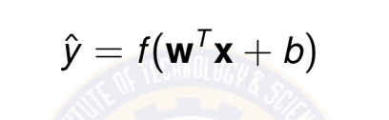
Linear Models Have Limitations
Recall: Linear models uses a single neuron with activation function f (·)
(1)
Problem: Many real-world relationships are non-linear
Image recognition (pixel intensities → object classes) Natural language understanding (words → sentiment) Medical diagnosis (symptoms → disease probability) Game playing (board state → optimal move)
Linear models cannot solve non-linearly separable problems!
Deep Learning

Slide 5
The XOR Problem
XOR (Exclusive OR): A classic non-linearly separable problem
Visual Representation:
Truth Table:
x₂
x₁ | x₂ | y (XOR)
0 | 0 | 0
0 | 1 | 1
1 | 0 | 1
1 | 1 | 0
1
0
No linear separator!
x₁
0
1
Challenge: No single straight line can separate the two classes!
Deep Learning

Slide 6
Why Single Neuron Fails on XOR
Single neuron model:
y^{ˆ} = σ(w₁x₁ + w₂x₂ + b)
(2)
where σ is any activation function.
Decision boundary: w₁x₁ + w₂x₂ + b = 0 (a line/hyperplane)
x₂
 | Fails
Fails
x₁
Conclusion: We need models that can learn non-linear decision boundaries!
Deep Learning

Slide 7

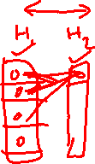
Solution: Multi-Layer Perceptron (MLP)
Key Idea: Stack multiple layers of neurons with non-linear activations
Input Layer ^{Hidden Layer} Output Layer
x₁
h₁
x₂
h₂
Non-linear activation functions enable non-linear boundaries
Deep Learning

Slide 8


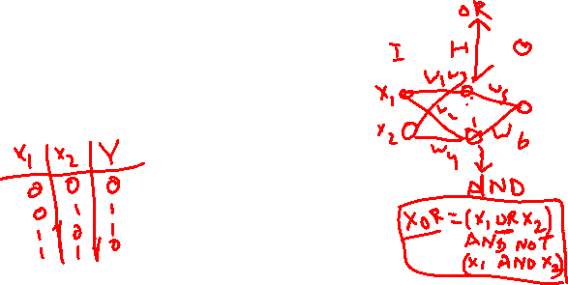
MLP Solves XOR
Architecture: 2 inputs → 2 hidden units → 1 output
How it works:
Hidden layer creates new feature representations Each hidden unit learns a linear separator
Output layer combines these separators
Non-linear activation enables complex boundaries
x₂
Hidden layer
!
x₁
h₁
Input Space
Hidden Space
Deep Learning

Slide 9


Table of Contents
Motivation: The XOR Problem
Non-Linearity in Neural Networks
The Four Components of DFNN
Training DFNN
Making Predictions
Impact of Depth and Width
DFNN Architecture Design Implementation Tips
Summary
1
2
3
4
5
6
7
8
9
Deep Learning

Slide 10
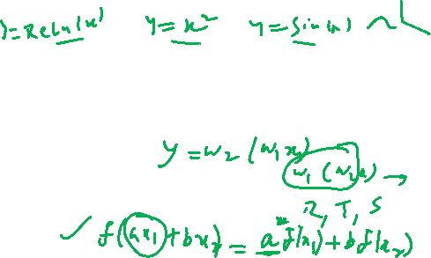
What is Non-Linearity?
Definition
A function f is non-linear if it does not satisfy the linearity property:
f (ax₁ + bx₂) ≠ a f (x₁) + b f (x₂)
(3)
for all scalars a, b and inputs x₁, x₂.
Why non-linearity matters:
Without non-linearity, deep networks collapse to single-layer models Non-linear activations enable learning complex patterns
Deep Learning

Slide 11
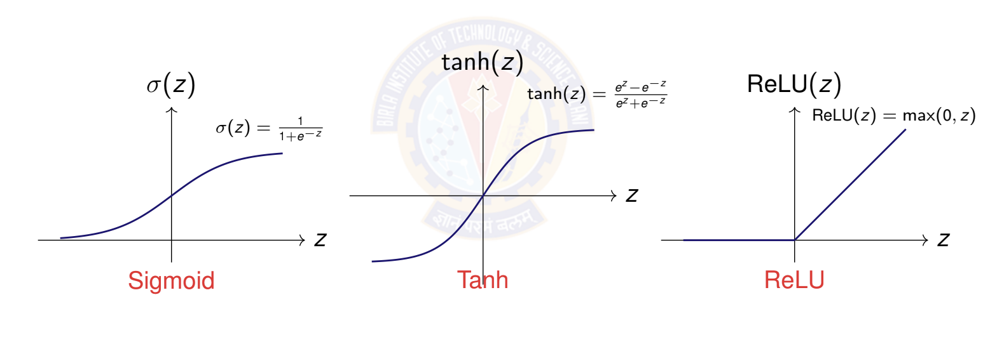

Common Activation Functions
Activation functions introduce non-linearity
Deep Learning
Notes:
SigmoidThis function maps input values to a range between 0 and 1. It is often used in the output layer for binary classification problems. A significant drawback is the vanishing gradient problem, where gradients become very small at the extremes, slowing down learning.
Tanh (Hyperbolic Tangent) Tanh maps input values to a range between -1 and 1. It is zero-centered, which often helps in faster convergence during training compared to the sigmoid function. It also suffers from the vanishing gradient problem.
ReLU (Rectified Linear Unit) ReLU outputs the input directly if it is positive, otherwise, it outputs zero. This function is computationally less expensive than Tanh and Sigmoid because it involves simpler mathematical operations. It is the most widely used activation function in deep learning due to its efficiency and ability to mitigate the vanishing gradient problem for positive inputs.

Slide 12
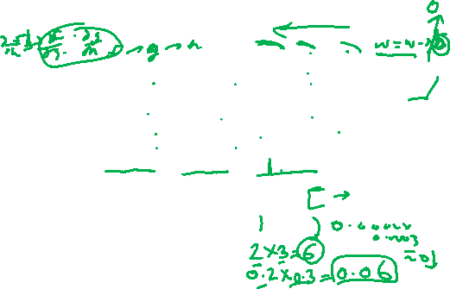
Activation Function Properties
Property | Sigmoid | Tanh | ReLU | Leaky ReLU
Range | (0, 1) | (−1, 1) | [0, ∞) | (−∞, ∞)
Zero-centered | x | ✓ | x | ✓
Differentiable | ✓ | ✓ | x at 0 | x at 0
Vanishing gradient | High | Moderate | No | No
Computational cost | High | High | Low | Low
Typical use | Output layer | Hidden layer | Hidden layer | Hidden layer
Modern preference: ReLU and variants for hidden layers Fast computation (simple thresholding)
No vanishing gradient for positive values Sparse activation (biological plausibility)
Deep Learning
Notes:
zero-centered refers to a data preprocessing technique called mean subtraction or zero-centering. This technique involves transforming the input data so that the mean of each feature or dimension becomes zero.
zero-centering helps to normalize the input data, making it more suitable for the optimization processes within neural networks and improving the stability and speed of training.
Gradients representing the rate of change (slope/derivative) of a loss function with respect to model parameters (weights/biases)
During the backpropagation process, the error is sent backward through the network to update the weights.
At each layer, the gradient is multiplied by the derivative of the activation function.If the derivatives are consistently small, the gradients can shrink exponentially with each layer they pass through, becoming "vanished" or near zero.This means the weights in the early layers (closer to the input) are not updated, and the network cannot learn complex features from the data.

Slide 13
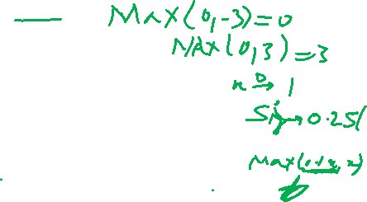
Why ReLU Works Well?
ReLU: f (z) = max(0, z)
Advantages:
1
Computational efficiency
⁾ Simple comparison and multiplication
⁾ Much faster than sigmoid/tanh (no exponentials)
Avoids vanishing gradients
⁾ Gradient is 1 for z > 0, flows unchanged through network
⁾ Enables training of very deep networks
Sparse activation
⁾ Many neurons output exactly 0
⁾ More efficient representations
⁾ Closer to biological neurons
2
3
Caveat: ”Dying ReLU” problem when neurons always output 0
Solution: Use Leaky ReLU, PReLU, or ELU variants
Deep Learning
Notes:
ReLU( Rectified Linear Unit) it outputs the input directly if positive, and zero if negative,

Slide 14

Table of Contents
Motivation: The XOR Problem
Non-Linearity in Neural Networks
The Four Components of DFNN
Training DFNN
Making Predictions
Impact of Depth and Width
DFNN Architecture Design
Implementation Tips
Summary
1
2
3
4
5
6
7
8
9
Deep Learning

Slide 15
Deep Feed-Forward Neural Network (DFNN)
Definition
A DFNN is a neural network with one or more hidden layers between input and output layers, where information flows forward through non-linear transformations.
Complete system requires four components:
Data: Input features and target outputs
Model: Multi-layer architecture with non-linear activations Objective Function: Loss function to minimize
Learning Algorithm: Backpropagation with gradient descent
1
2
3
4
This is the same framework as linear models, but with added depth and non-linearity!
Deep Learning

Slide 16
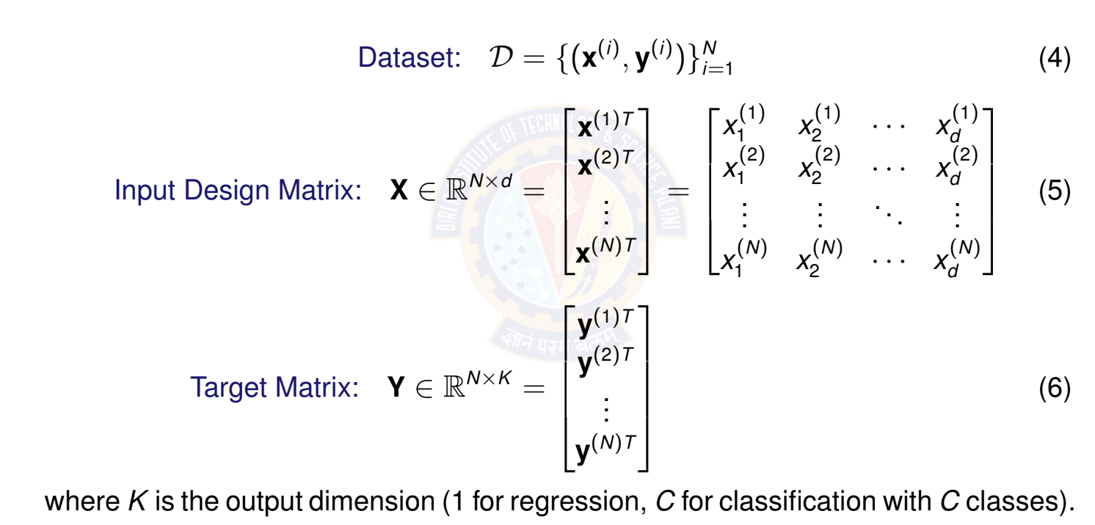
Data Representation
Deep Learning

Slide 17
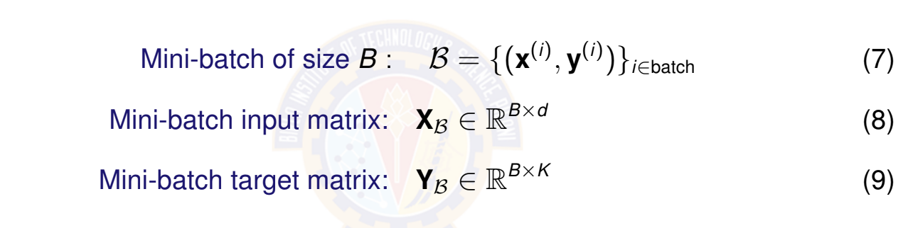
Mini-Batch Representation
For computational efficiency, we process data in mini-batches
Common batch sizes: B ∈ {32, 64, 128, 256}
Balances computational efficiency with gradient stability Enables parallelization on GPUs
Deep Learning

Slide 18
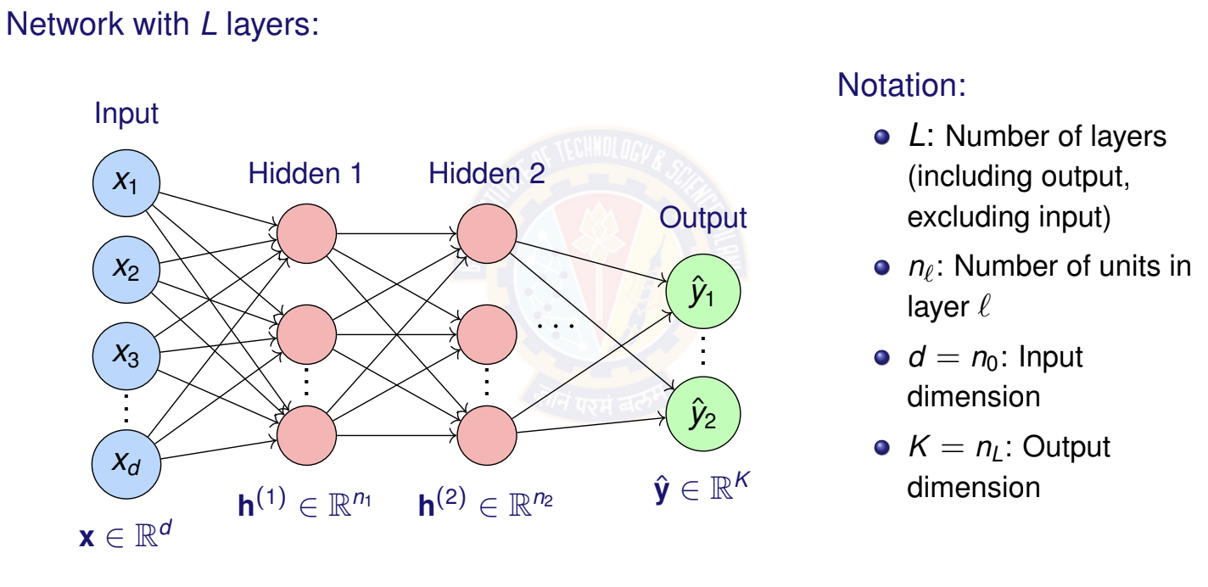
DFNN Architecture
Deep Learning

Slide 19
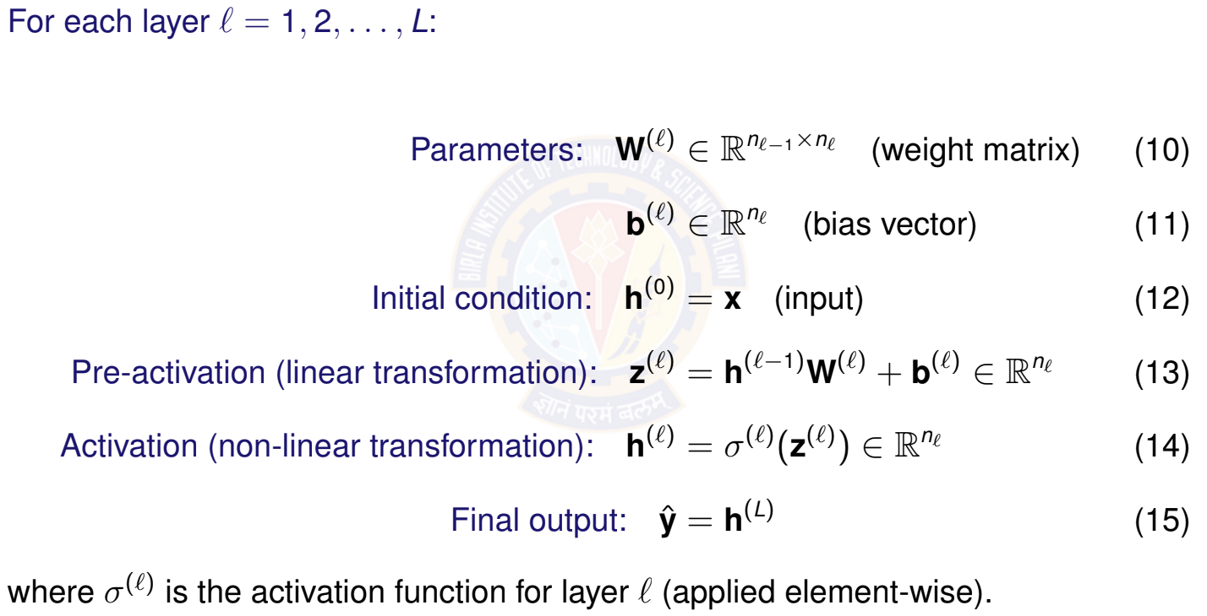
Layer-wise Computation
Deep Learning

Slide 20
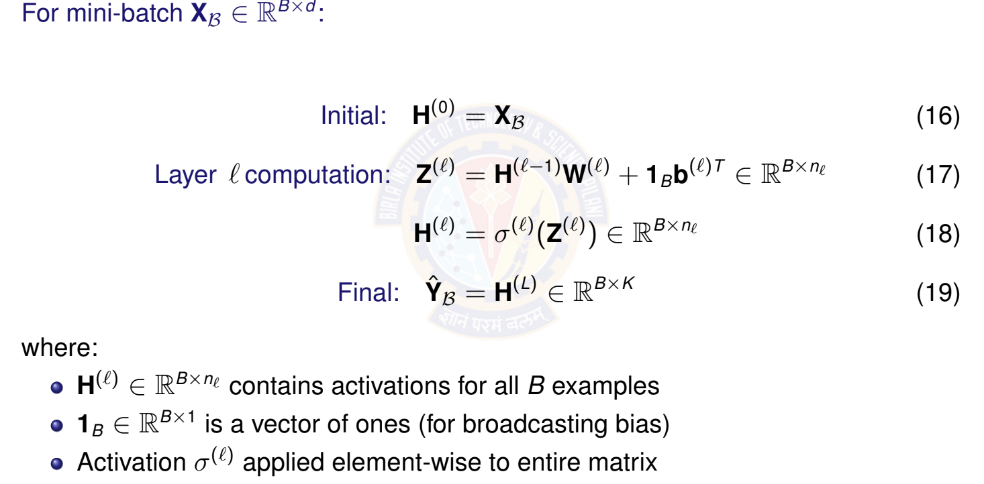
Vectorized Computation for Mini-Batch
Deep Learning

Slide 21
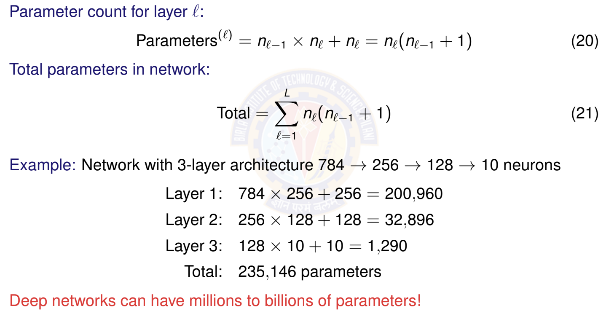
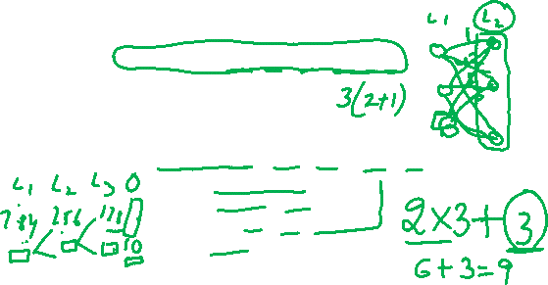
Total Parameters in Network
Deep Learning
21 / 67

Slide 22
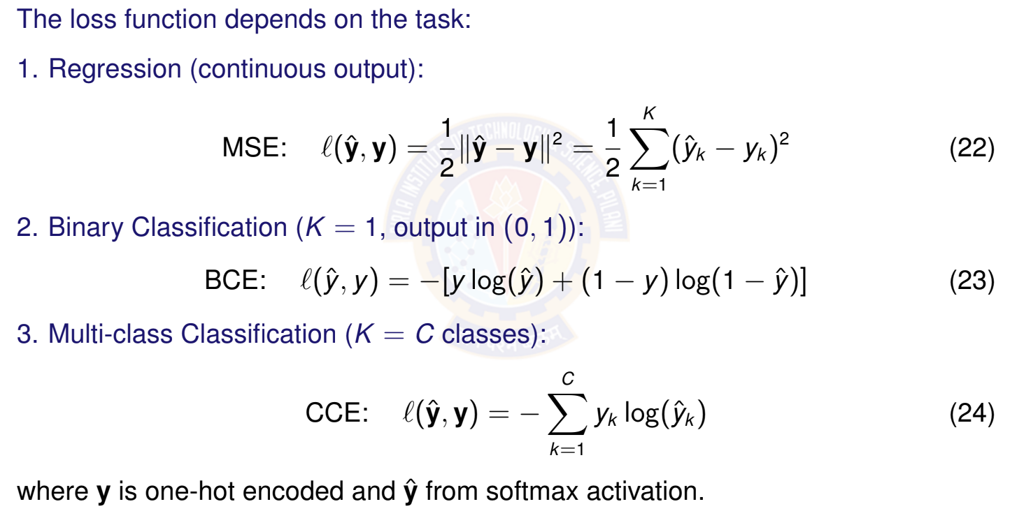
Loss Functions for Different Tasks
Deep Learning

Slide 23
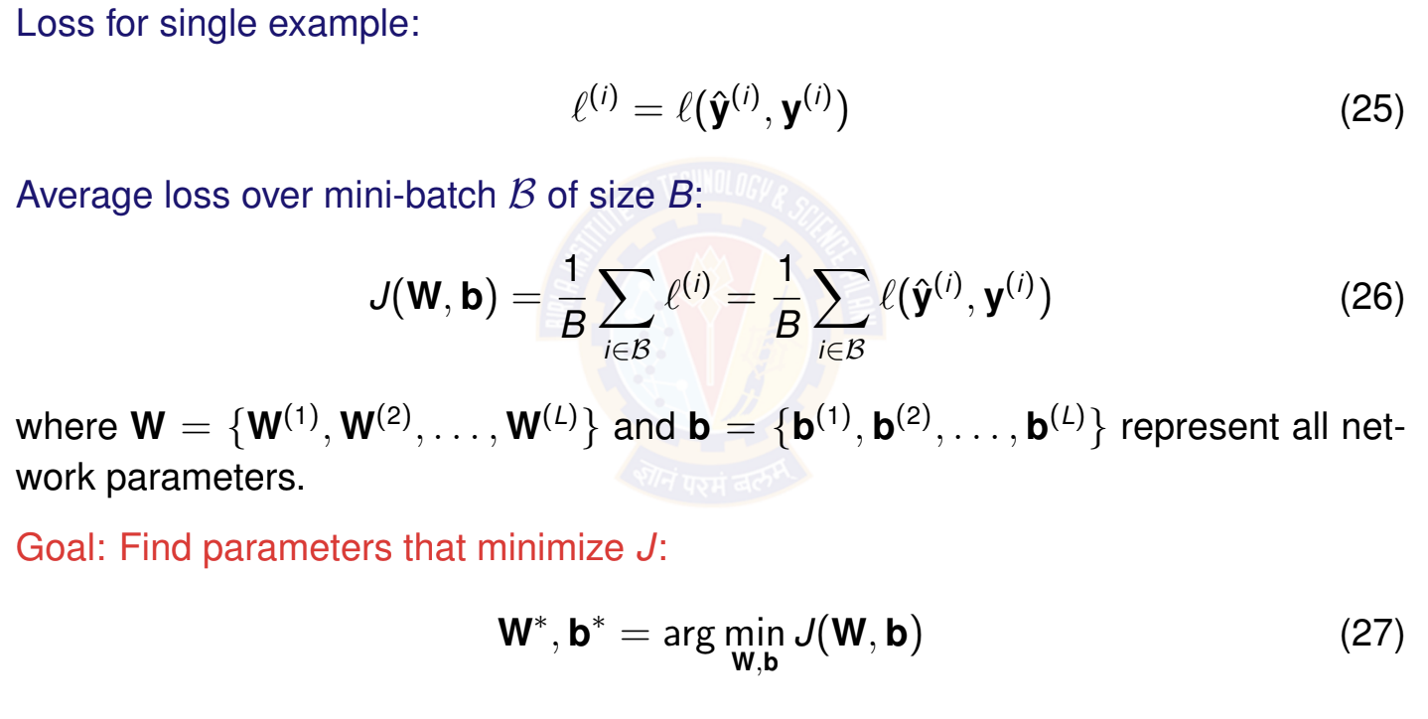
Total Loss Over Mini-Batch
Deep Learning

Slide 24
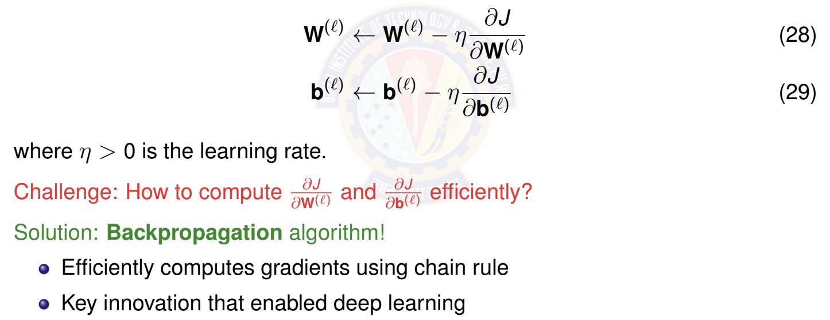
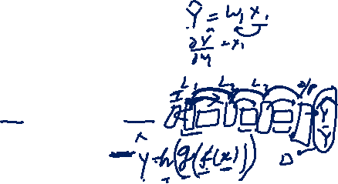
Mini-Batch Stochastic Gradient Descent
Core idea: Update parameters using gradients from mini-batches Update rule for layer l:
Deep Learning

Slide 25
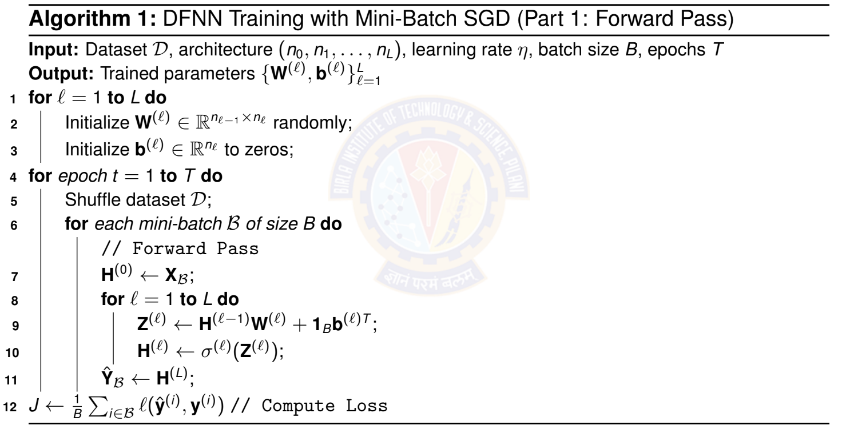
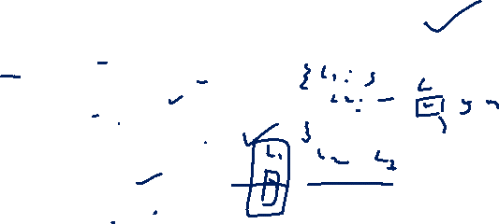
Training Algorithm: Mini-Batch SGD
Deep Learning

Slide 26
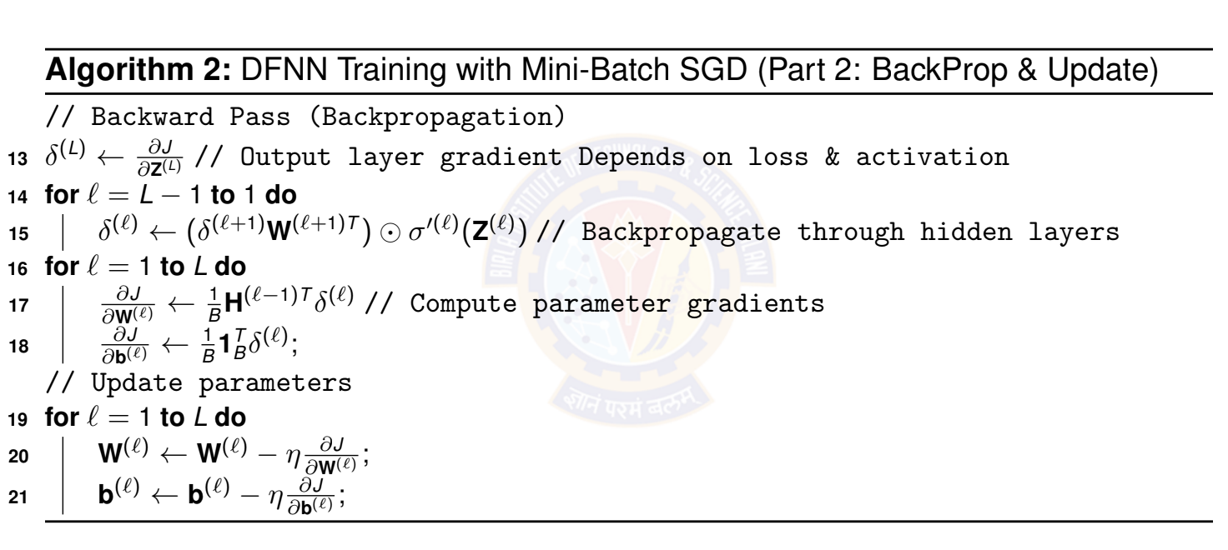
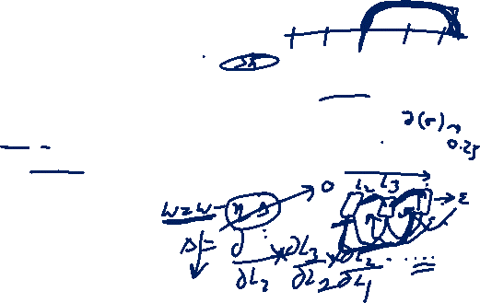
Training Algorithm: Mini-Batch SGD
Deep Learning

Slide 27

References
Goodfellow et al. ”Deep Learning” - Chapter 6
http://www.deeplearningbook.org/
Zhang et al. ”Dive into Deep Learning” - Chapters 4, 5 https://d2l.ai/ Nielsen, M. ”Neural Networks and Deep Learning”
http://neuralnetworksanddeeplearning.com/
Deep Learning

